Slide 1

Interactive Finite Automata Generator: Regular Expression to NFA and DFA
Department of CSE
COURSE: COMPILER DESIGN –(24CS2235F)
SECTION-5
Review-1
Team-12
Under the Guidance of: P.Krishna Kishore
Team Members
2420030046-N.Lasya
2420030471-N.Nikitha Reddy
2420030119-C.Akshara

Slide 2
Introduction
Regular Expressions and Finite Automata are fundamental concepts in Compiler Design and Formal Language Theory. Regular Expressions provide a concise way to describe patterns, while Finite Automata provide a computational model for recognizing those patterns. The conversion of a Regular Expression into an NFA and subsequently into a DFA is an important process used in areas such as lexical analysis and pattern recognition.
However, manually performing these conversions can be difficult to understand because they involve multiple states, transitions, epsilon transitions, epsilon closures, and state combinations.
The proposed project, “Interactive Finite Automata Generator: Regular Expression to NFA and DFA,” is a web-based application that automates this conversion process. The user can enter a valid Regular Expression, and the system dynamically generates its corresponding NFA using Thompson’s Construction and converts the NFA into a DFA using Subset Construction.
The application provides transition tables and interactive graphical visualizations of both NFA and DFA, allowing users to understand the conversion process clearly and interactively.

Slide 3
Abstract
The project “Interactive Finite Automata Generator: Regular Expression to NFA and DFA” is a web-based application developed to simplify the understanding of Regular Expressions and Finite Automata concepts in Compiler Design. The system allows users to enter a Regular Expression through an interactive user interface and automatically generates the corresponding NFA (Non-Deterministic Finite Automaton) and DFA (Deterministic Finite Automaton).
The system first validates the given Regular Expression and converts it into postfix notation. It then uses Thompson’s Construction to generate the NFA and Subset Construction to convert the NFA into a DFA. The generated automata are presented through transition tables and interactive graphical visualizations, including start states, accepting states, transitions, and epsilon transitions.
The application is developed using React and Vite for the frontend and Python Flask for the backend. The system supports common Regular Expression operators such as union (|), concatenation, Kleene star (*), plus (+), optional (?), and parentheses. Since the system is dynamic, users can enter different Regular Expressions without modifying the program. The project provides a practical learning platform for understanding Compiler Design, Regular Expressions, NFA, DFA, Thompson’s Construction, and Subset Construction.

Slide 4
Objectives
The main objectives of the project are:
To develop an interactive web-based tool for converting Regular Expressions into finite automata.
To automatically generate an NFA using Thompson’s Construction.
To convert the generated NFA into a DFA using Subset Construction.
To provide dynamic Regular Expression input without requiring changes to the source code.
To display NFA and DFA transition tables clearly.
To provide interactive graphical visualizations of NFA and DFA states and transitions.
To implement Regular Expression validation and provide meaningful error messages for invalid expressions.
To help students understand important concepts such as epsilon transitions, epsilon closure, state transitions, and DFA state formation.
To reduce the complexity of manually performing Regular Expression to NFA and DFA conversions.
To provide an easy-to-use educational tool for Compiler Design and Formal Languages.

Slide 5
Proposed Methodology
The proposed system follows a sequential conversion methodology:
Step 1: Regular Expression Input
The user enters a Regular Expression through the web interface.
Example:
(a|b)*abb
The system supports operators such as:
| Union
. Concatenation
* Kleene Star
+ One or More
? Optional
() Grouping
Step 2: Regular Expression Validation
The backend checks whether the entered Regular Expression is syntactically valid.
It detects errors such as:
Empty input
Mismatched parentheses
Invalid operators
Incorrect operator placement
If the expression is invalid, the system displays an appropriate error message.

Slide 6
Step 3: Infix to Postfix Conversion
The validated Regular Expression is converted from infix notation into postfix notation.
For example:
(a|b)*abb
is converted into an equivalent postfix expression.
This makes it easier to process the expression algorithmically.
Step 4: Thompson’s Construction
The postfix Regular Expression is processed using Thompson’s Construction.
The system creates NFA states and transitions for:
Symbols
Union
Concatenation
Kleene Star
Plus
Optional
Epsilon (ε) transitions are used wherever required.
Step 5: NFA Generation
The resulting NFA contains:
Start state
Intermediate states
Accepting state
Symbol transitions
Epsilon transitions
The NFA transition table and graphical representation are then generated.

Slide 7
Step 6: Epsilon Closure
For NFA-to-DFA conversion, the system calculates the epsilon closure of NFA states.
The epsilon closure identifies all states reachable through epsilon transitions without consuming an input symbol.
Step 7: Subset Construction
The system uses Subset Construction to convert the NFA into a DFA.
Each DFA state represents a set of NFA states.
For example:
A = {q0, q1, q3}
B = {q2, q4}
C = {q5}
The process continues until all possible DFA states and transitions are generated.
Step 8: DFA Generation
The resulting DFA contains:
DFA start state
DFA states
DFA transitions
DFA accepting states
The DFA transition table and graphical representation are displayed.

Slide 8
Step 9: Visualization
The frontend displays the generated NFA and DFA as interactive graphs.
Users can:
View states
View transitions
Identify start states
Identify accepting states
Zoom
Pan
Examine the automata structure

Slide 9
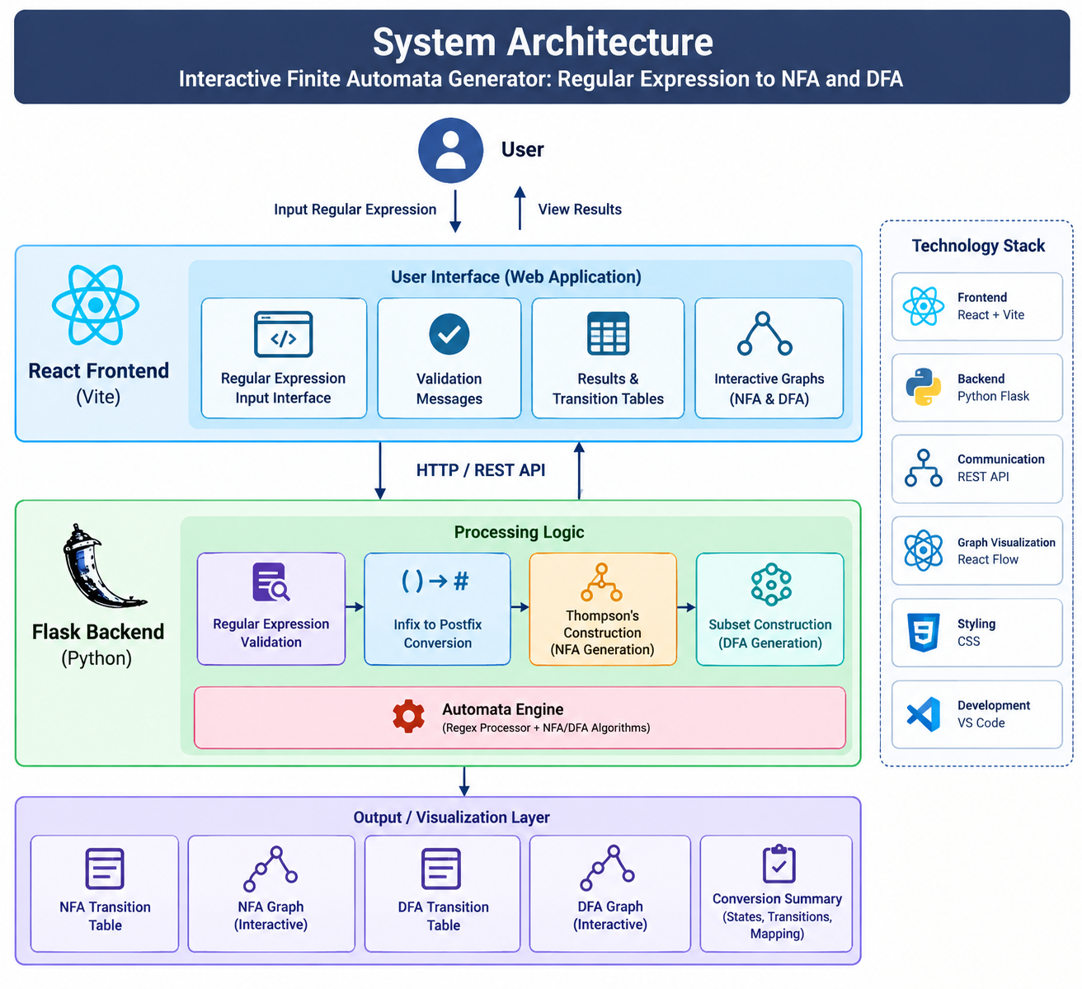
System Architecture

